Slide 1
SVAD 150 CAPSTONE PROJECT
Matthew Newland

Slide 2
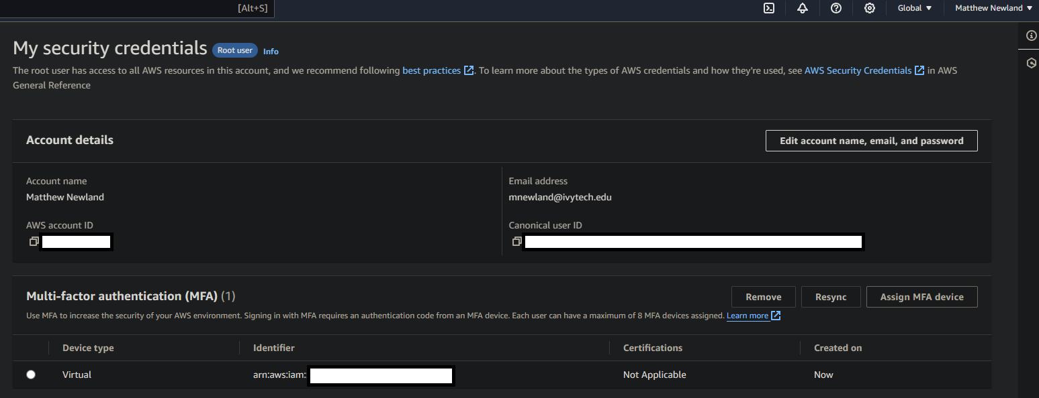
MFA ON ROOT ACCOUNT

Slide 3
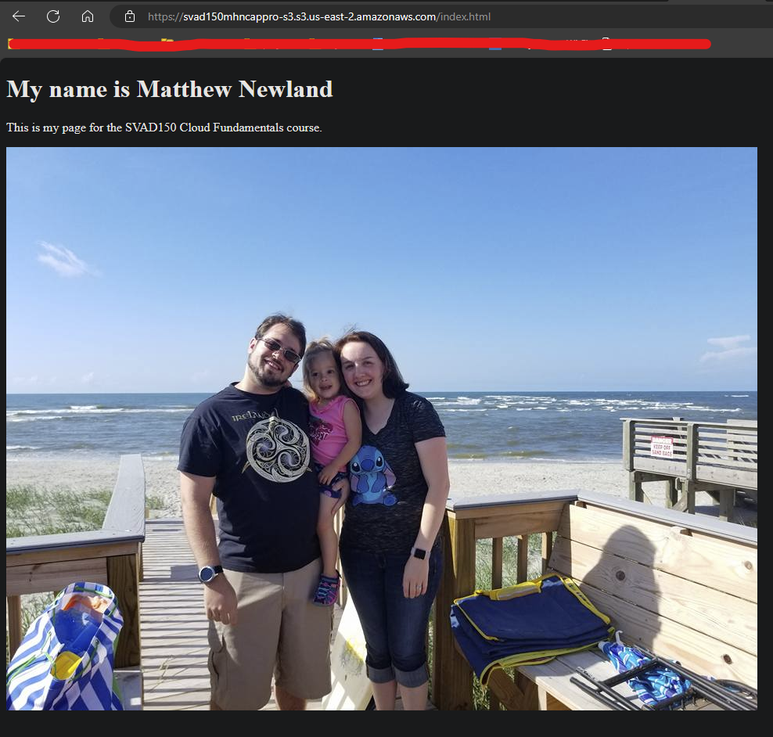
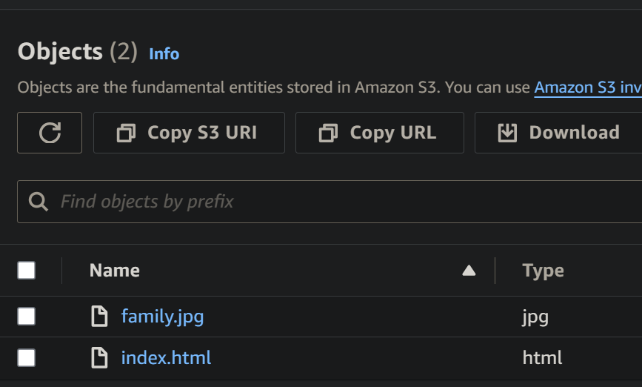
AWS S3 BUCKET

Slide 4
S3 BUCKET POLICY
{
"Version": "2012-10-17",
"Statement": [
{
"Sid": “SVAD150MHNCapPro-S3-GetObj",
"Effect": "Allow",
"Principal": "*",
"Action": "s3:GetObject",
"Resource": "arn:aws:s3:::svad150mhncappro-s3/*"
}
]
}

Slide 5
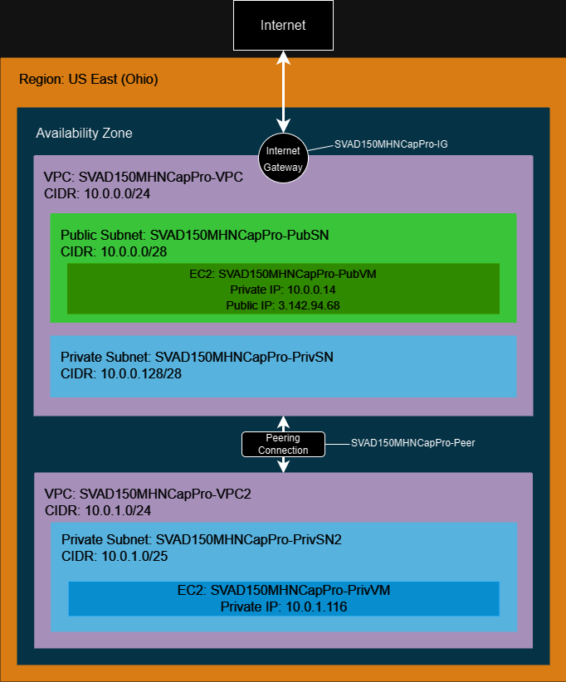
DEPLOYMENT
SVAD150MHNCapPro-VPC
private and public subnet
Internet Gateway
SVAD150MHNCapPro-VPC2
Only private subnet
Peering connection: SVAD150MHNCapPro-Peer

Slide 6
SVAD150MHNCAPPRO-PEER
Requester:
VPC: SVAD150MHNCapPro-VPC
CIDRs: 10.0.0.0/24
Accepter:
VPC: SVAD150MHNCapPro-VPC2
CIDRs: 10.0.1.0/24

Slide 7
NACL SETUP
SVAD150MHNCapPro-VPC-NACL
Subnets:
SVAD150MHNCapPro-PubSN
SVAD150MHNCapPro-VPC2-NACL
Subnets:
SVAD150MHNCapPro-PrivSN2

Slide 8
SVAD150MHNCAPPRO-VPC-NACL RULES
Inbound
Rule number | Type | Protocol | Port range | Source | Allow/Deny
97 | Custom TCP | TCP (6) | 0 | 10.0.1.0/24 | Allow
98 | All IMCP – IPv4 | ICMP (1) | All | 0.0.0.0/0 | Allow
99 | RDP (3389) | TCP (6) | 3389 | 0.0.0.0/0 | Allow
100 | All traffic | All | All | 0.0.0.0/0 | Allow
* | All traffic | All | All | 0.0.0.0/0 | Deny
Outbound
Rule number | Type | Protocol | Port range | Source | Allow/Deny
98 | Custom TCP | TCP (6) | 0 | 10.0.1.0/24 | Allow
99 | All IMCP – IPv4 | ICMP (1) | All | 0.0.0.0/0 | Allow
100 | All traffic | All | All | 0.0.0.0/0 | Allow
* | All traffic | All | All | 0.0.0.0/0 | Deny

Slide 9
SVAD150MHNCAPPRO-VPC2-NACL RULES
Inbound
Rule number | Type | Protocol | Port range | Source | Allow/Deny
97 | Custom TCP | TCP (6) | 0 | 10.0.0.0/24 | Allow
98 | RDP (3389) | TCP (6) | 3389 | 10.0.0.0/24 | Allow
99 | All IMCP – IPv4 | ICMP (1) | All | 10.0.0.0/24 | Allow
* | All traffic | All | All | 10.0.0.0/24 | Deny
Outbound
Rule number | Type | Protocol | Port range | Source | Allow/Deny
97 | RDP (3389) | TCP (6) | 3389 | 10.0.0.0/24 | Allow
98 | All IMCP – IPv4 | ICMP (1) | All | 10.0.0.0/24 | Allow
99 | Custom TCP | TCP (6) | 0 | 10.0.0.0/24 | Allow
100 | All traffic | All | All | 0.0.0.0/0 | Allow
* | All traffic | All | All | 0.0.0.0/0 | Deny

Slide 10
ROUTE TABLE
SVAD150MHNCapPro-RT
VPCs:
SVAD150MHNCapPro-VPC
Subnets:
SVAD150MHNCapPro-PubSN
Routes
SVAD150MHNCapPro-RT2
VPCs:
SVAD150MHNCapPro-VPC2
Subnets:
SVAD150MHNCapPro-PrivSN2
Routes
Destination | Target | Status
0.0.0.0/0 | SVAD150MHNCapPro-IG | Active
10.0.0.0/24 | Local | Active
10.0.1.0/24 | SVAD150MHNCapPro-Peer | Active
Destination | Target | Status
10.0.0.0/24 | SVAD150MHNCapPro-Peer | Active
10.0.1.0/24 | Local | Active

Slide 11
SECURITY GROUP SETUP
SVAD150MHNCapPro-PubSG
SVAD150MHNCapPro-VPC
Inbound
Outbound
SVAD150MHNCapPro-PrivSG
SVAD150MHNCapPro-VPC2
Inbound
Outbound
Type | Protocol | Port range | Source
RDP | TCP | 3389 | 0.0.0.0/0
All ICMP – Ipv4 | ICMP | All | 0.0.0.0/0
Custom TCP | TCP | 0 | 10.0.1.0/24
Type | Protocol | Port range | Source
Custom TCP | TCP | 0 | 10.0.0.0/24
RDP | TCP | 3389 | 10.0.0.0/24
All ICMP – Ipv4 | ICMP | All | 10.0.0.0/24
Type | Protocol | Port range | Source
All ICMP – Ipv4 | ICMP | All | 0.0.0.0/0
Custom TCP | TCP | 0 | 10.0.1.0/24
All traffic | All | All | 0.0.0.0/0
Type | Protocol | Port range | Source
Custom TCP | TCP | 0 | 10.0.0.0/24
All traffic | All | All | 0.0.0.0/0
All ICMP – Ipv4 | ICMP | All | 0.0.0.0/0

Slide 12
GENERAL EC2 SETUP
OS:
Microsoft Windows Server 2022 Base (free tier)
Instance Type:
t2.micro (free tier)
Key Pair:
The Key Pair I set up at the beginning of the term
Network Settings:
Auto Assign public IP: enabled
Storage:
30 GiB gp2 (free tier)

Slide 13
EC2 INDIVIDUAL SETTINGS
SVAD150MHNCapPro-PubVM
VPC: SVAD150MHNCapPro-VPC
Subnet: SVAD150MHNCapPro-PubSN
Security Group: SVAD150MHNCapPro-PubSG
SVAD150MHNCapPro-PrivVM
VPC: SVAD150MHNCapPro-VPC2
Subnet: SVAD150MHNCapPro-PrivSN2
Security Group: SVAD150MHNCapPro-PrivSG
Alarm: NetworkIn SVAD150 Priv VM

Slide 14
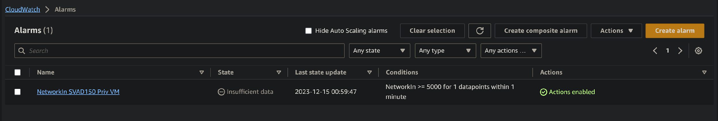
CLOUDWATCH ALARM
Conditions:
NetworkIn >= 5000 for 1 datapoints within 1 minute
EC2 instance:
SVAD150MHNCapPro-PrivVM

Slide 15
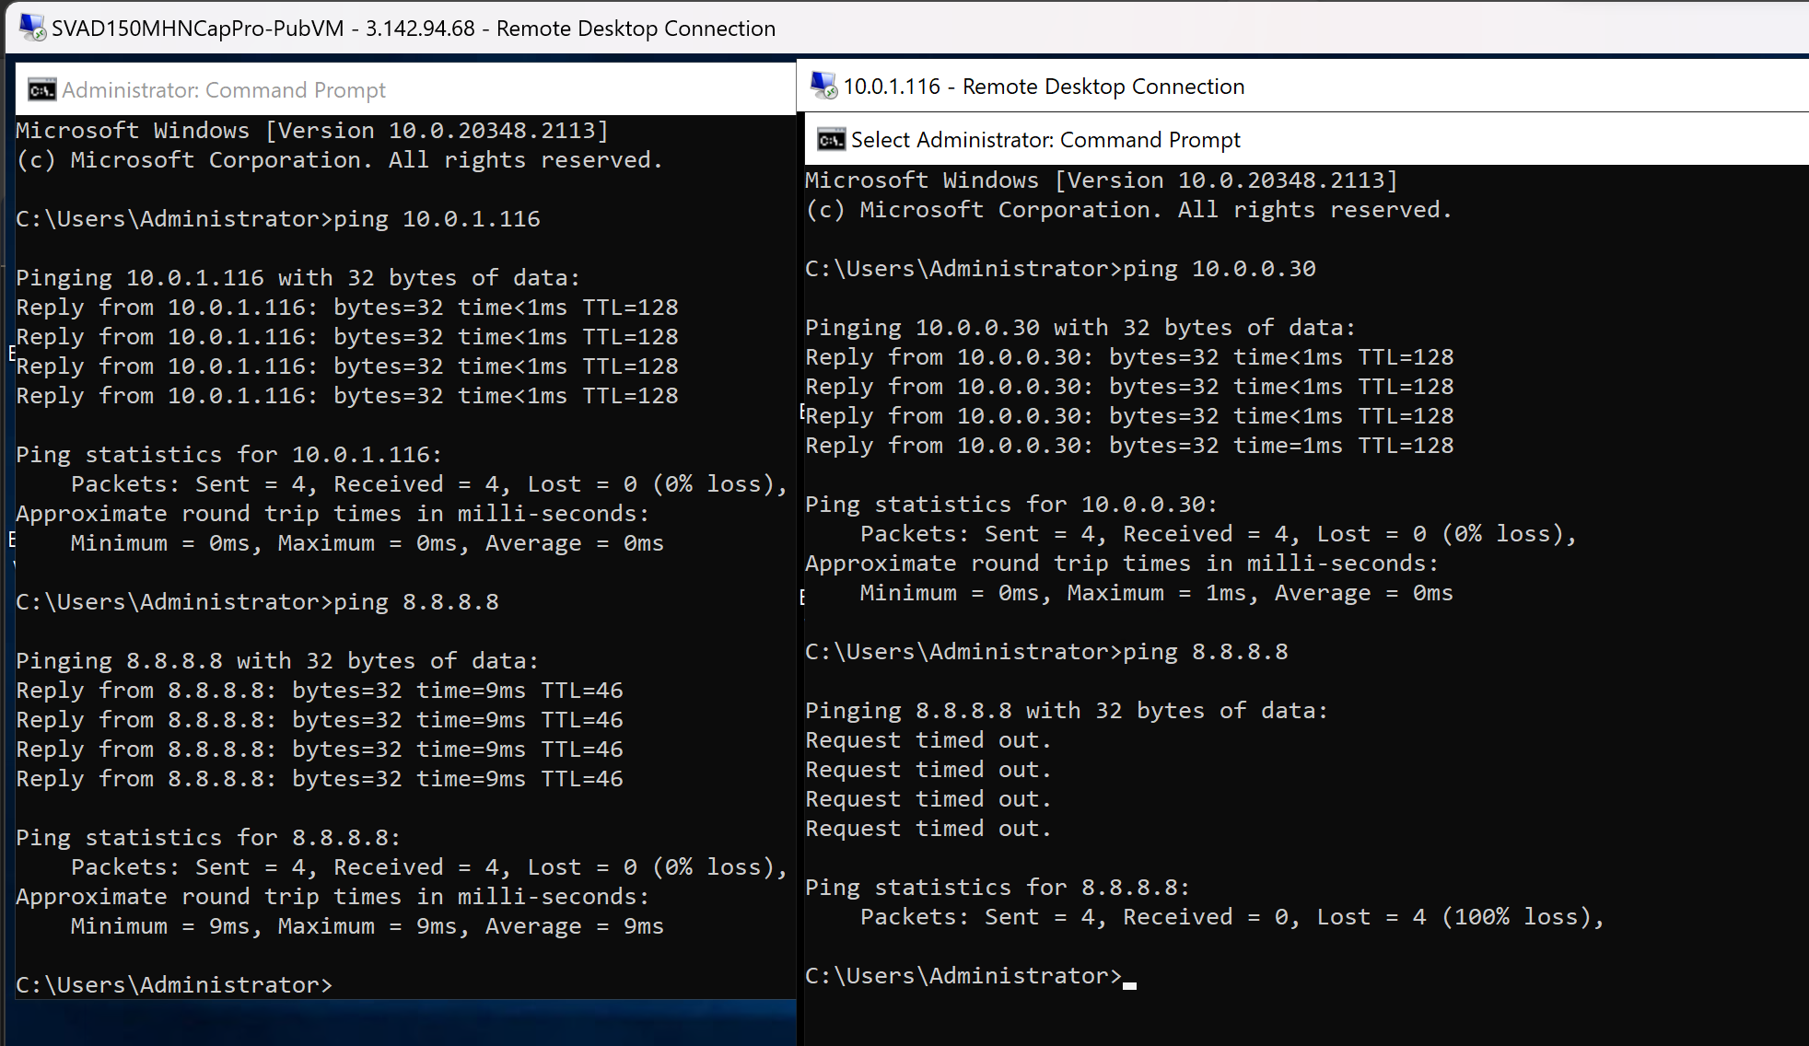
CONNECTION TEST

Slide 16
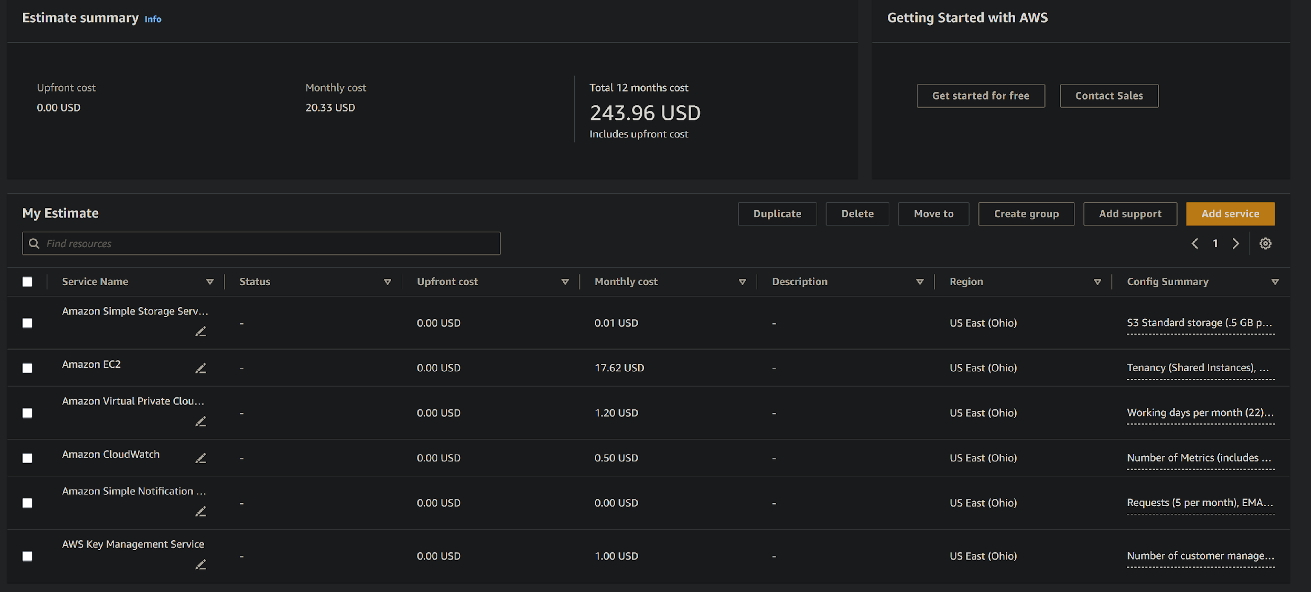
ESTIMATED COST
Notes:
$20.33/mo.

Slide 17
COST BREAKDOWN
S3 – $0.01/mo.
0.5 GB Standard Storage
20 GET, SELECT, and all other requests from S3 Standard
VPC – $1.20/mo.
VPN connection
Site-to-site
1 connection
24 hours/month
AWS Key Management Service - $1.00/mo.
Number of customer managed Customer Master Keys (CMK): 1
Number of Symmetric requests: 200

Slide 18
COST BREAKDOWN (CONT’D)
EC2 – $17.62/mo.
Tenancy: Shared
OS: Windows Server
Workload
Monthly spike traffic
Baseline instances: 2
Peak instances: 3
Peak duration: 1 day
Instances: t2.micro
EC2 Instance Savings Plan
1 year
No upfront

Slide 19
COST BREAKDOWN (CONT’D)
CloudWatch Alarm - $0.50/mo.
APIs
GetMetricData Number of metrics requested: 1
Dashboards and alarms
Number of dashboards: 1
Number of Standard Resolution Alarm Metrics: 1
Number of alarms defined with a Metrics Insights query: 1
Number of metrics scanned by each Metrics Insights query: 1
Simple Notification Service - $0.01/mo.
Topics: Standard topics
Requests: 5 per month
Email/Email-JSON Notifications: 5 per month

